Slide 1
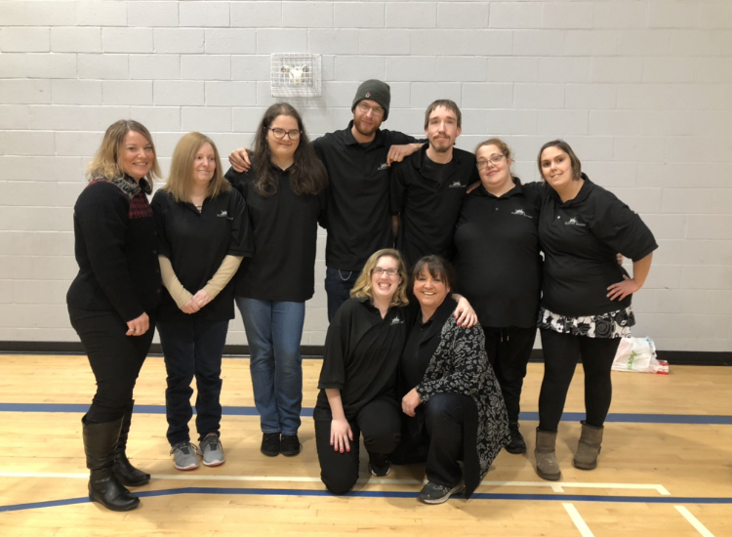
Employment Services
Summer Street Industries
January
2020

Slide 2
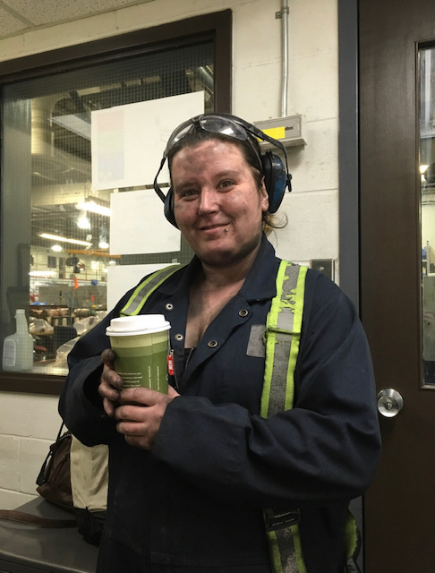
Our Mission
To create and facilitate opportunities for those with disabilities

Slide 3
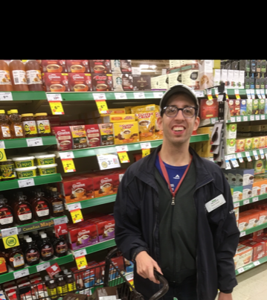
Strategic Plan
The strategic plan that our department bases our daily resources into the most is to Increase stipends and earning potential for Summer Street Clients.
We feel that everyone deserves an opportunity to earn a competitive wage and our team is dedicated to help our participants reach their employment goals.

Slide 4
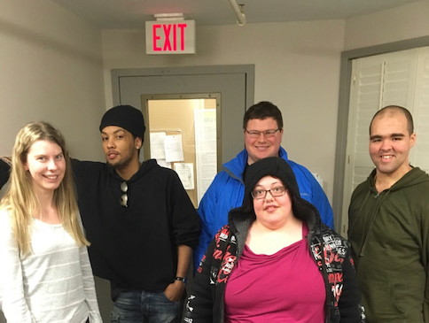
Training
On site training is the first step for those interested in Community Employment
This includes:
  Job Readiness
  Health & Safety
  Catering Training
  Maintenance training

Slide 5
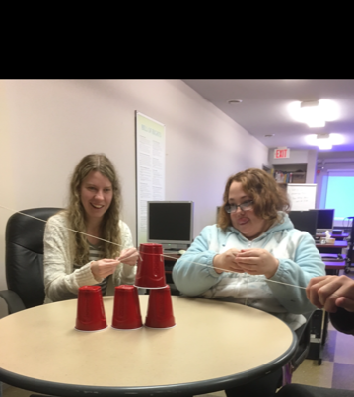
Job Readiness
This is the first step for participants whose goals are to work out in the community
Here they will learn about the soft-skills necessary for obtaining and maintaining employment in the community. Some of these soft skills include:
Interpersonal skills
Working as a team
Problem Solving
Time Management
Communication

Slide 6
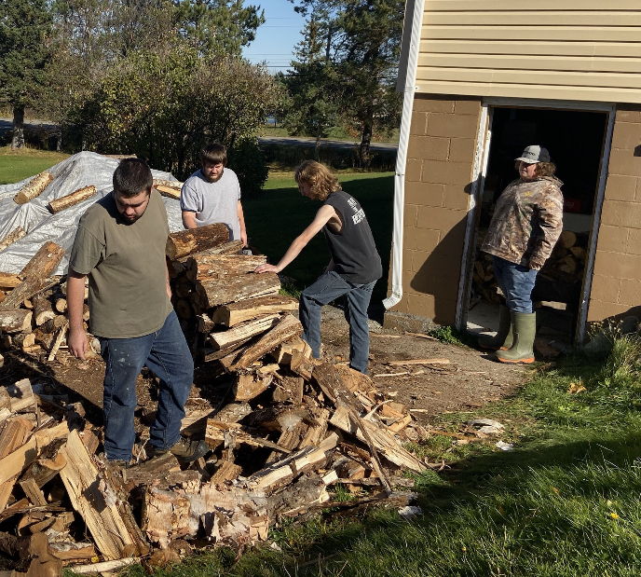
Health & Safety
Topics include
Safety awareness
Proper lifting techniques
PPE (Personal Protective Equipment
WHMIS
First Aid

Slide 7
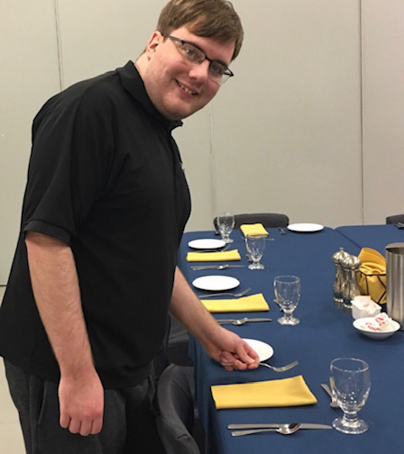
Catering Training
Rotary and Gyro provide weekly training opportunities for those whose goals are to work on our catering team or in the food services industry.
Training includes:
Customer Service
Money Skills
Food Prep
Table Setup
Serving
Clearing
Bartending
Dishwashing

Slide 8
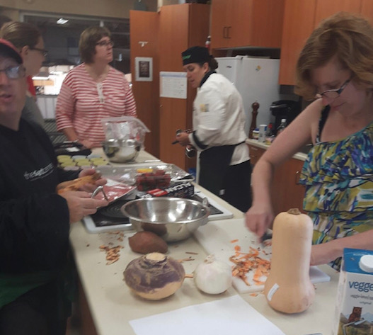
Sobeys Cooking Program
Chef Courtney runs this program at the East Side Sobeys
Participants choose what meal is prepared each week
Chef Courtney takes the group around the store to gather ingredients then the group go upstairs to the kitchen to prepare themselves a different meal each week
This popular program benefits those who are interested in food services and anyone who is working towards independent living

Slide 9
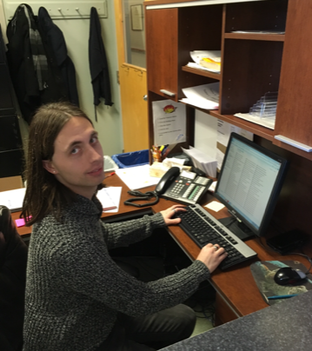
Social Enterprises
Social Enterprises here at Summer Street provides employment opportunities for an average of 40-50 individuals each month
These opportunities include:
Catering
Front Office
New Beginnings
Maintenance
Trophies
LEP Kitchen

Slide 10
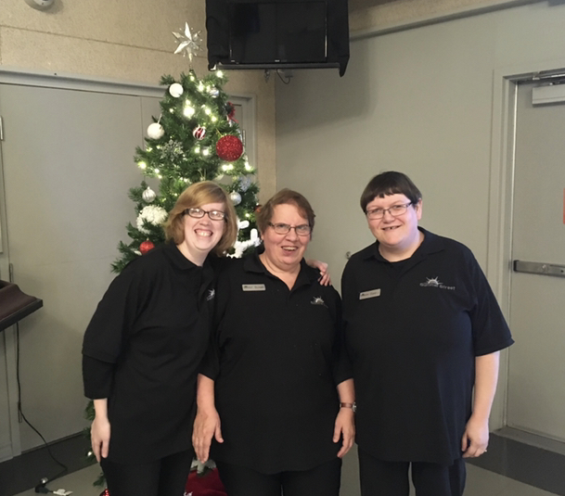
Catering
Our catering team

Slide 11
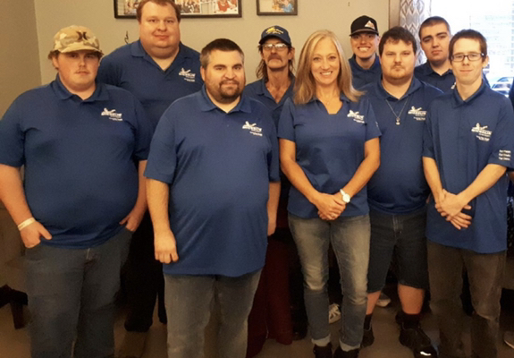
Michelin
Our contract with Michelin provides employment for 10 employees with 2 more set to join the team this month
Our employees play a big role in the tire making process and we look forward to this contract providing more opportunities for those who would like to work in an industrial setting

Slide 12
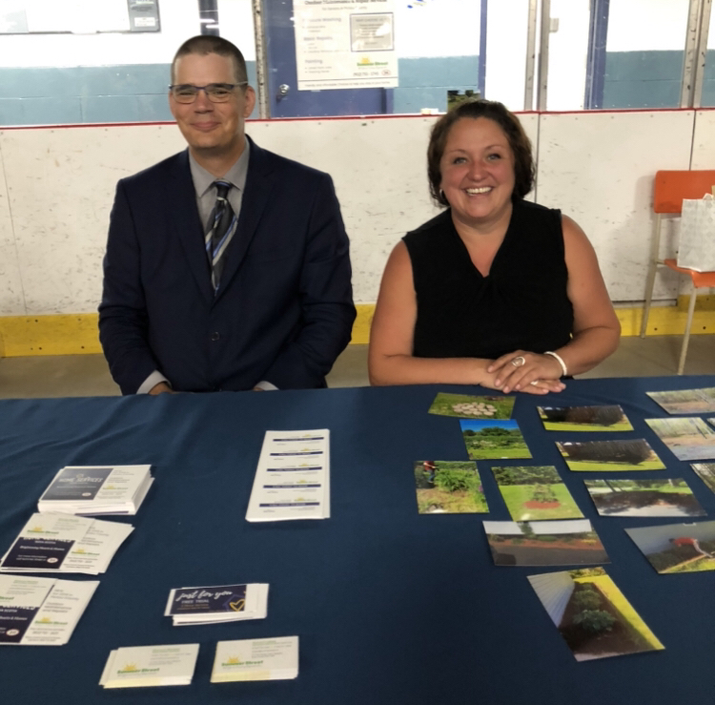
Home Services for Seniors
We have partnered with Directions NS and the Pictou County Seniors Council for this pilot project
The purpose of this project is to provide home services to Seniors in the County while increasing employment opportunities for those we support.
The project has provided valuable training and employment opportunities for 12 individuals

Slide 13
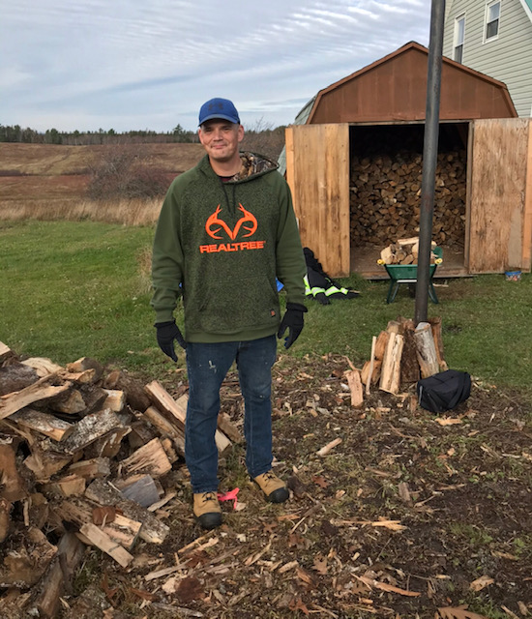
Home Services
To date 25 jobs have been completed and many jobs have resulted in continued service.
The various jobs completed include:
  Lawn Care
  Gardening
  Cleaning
  Pressure Washing
  Painting
  Wood Piling
  Leave Raking

Slide 14
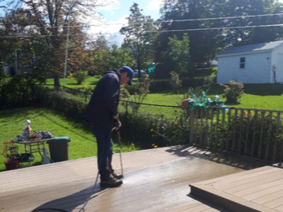
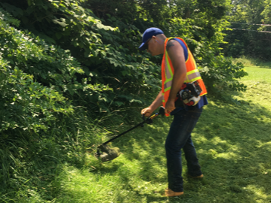
Pressure Washing & Lawn Care

Slide 15
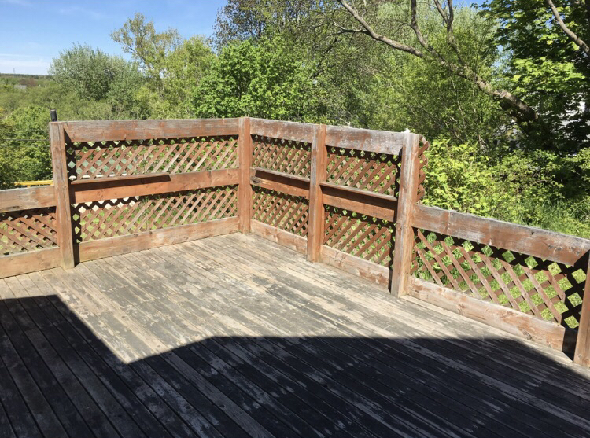
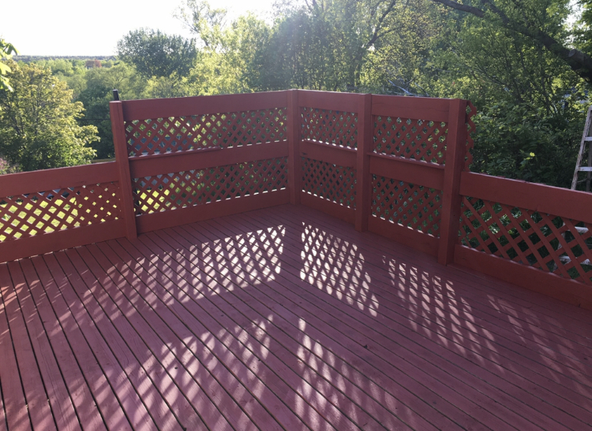
Exterior Painting
Before:
After:

Slide 16
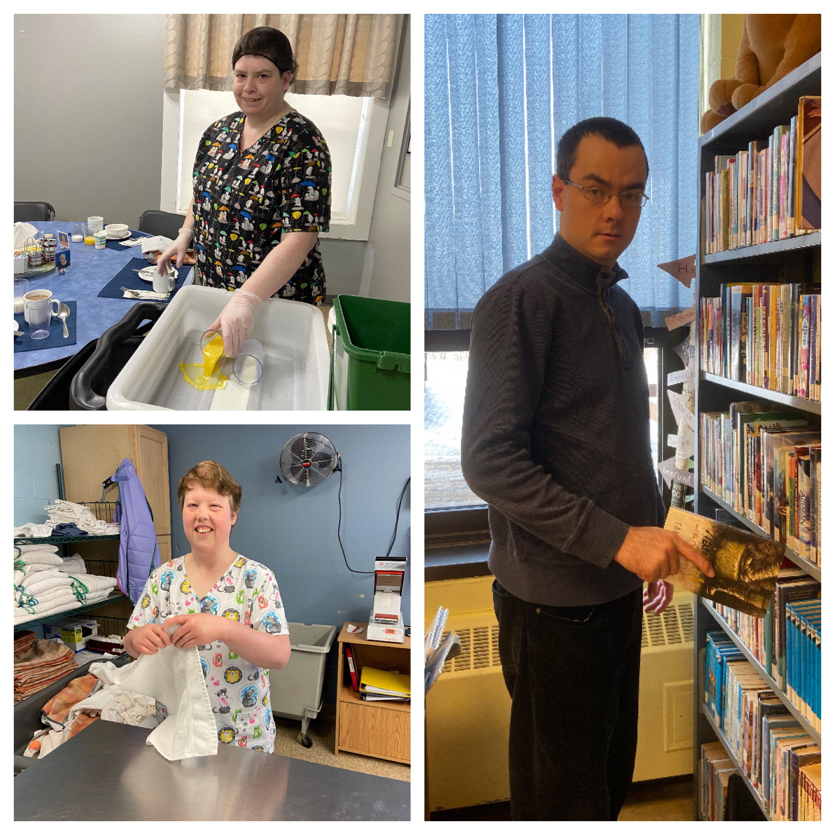
Employment in the Community
We have relationships with over 50 inclusive employers throughout Pictou County that provide employment for our guys
Our team is always on the lookout for any new opportunities

Slide 17
Sobeys Annual Christmas Party
We recently worked our third coat check at Sobeys annual Christmas party at the Wellness Center
Employees earned $20/hr plus tips
We are already booked in for next year. A great partnership that we look forward to continuing.

Slide 18
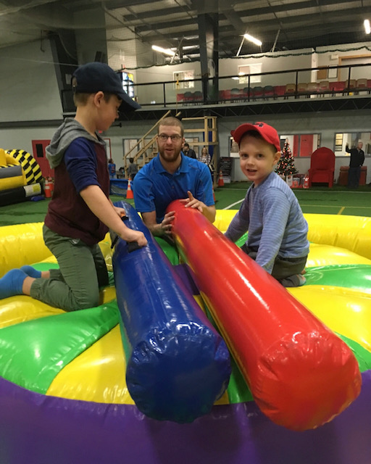
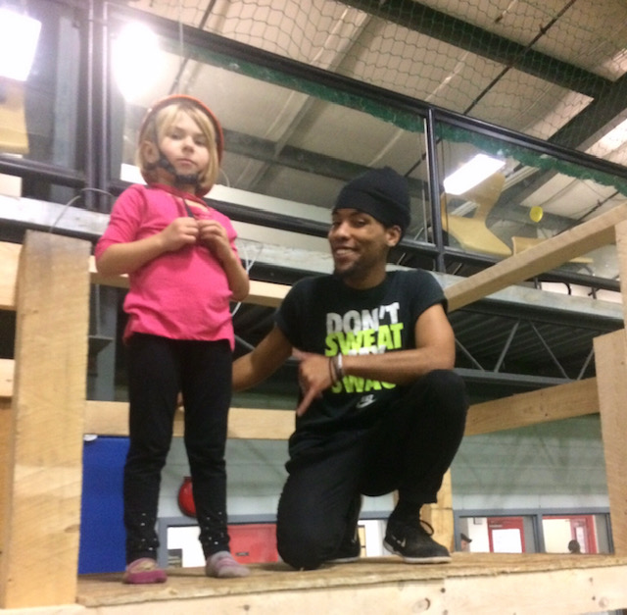
William M Sobey Indoor Sports Complex
Jeremy
Jacob

Slide 19
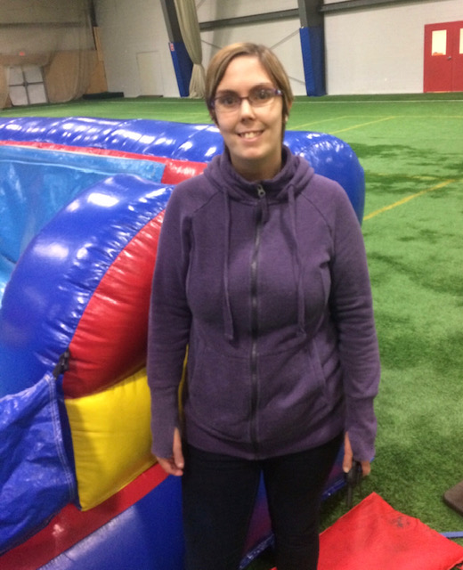
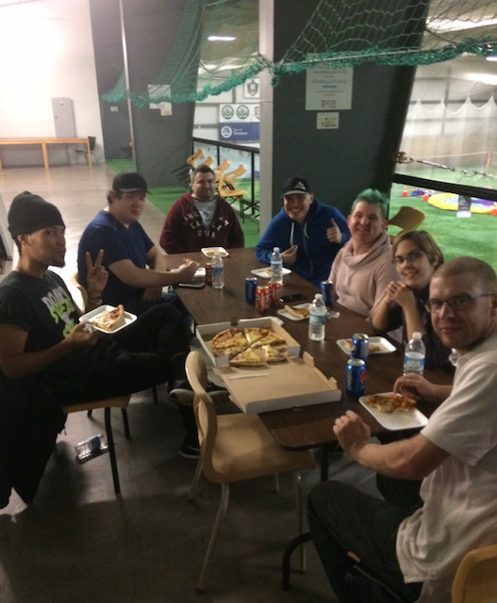
William M Sobey Sports Complex

Slide 20
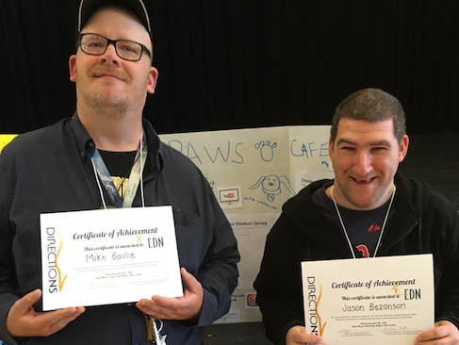
Entrepreneurs
We also do our best to support entrepreneurial endeavors
We will be securing a table at the Flea Market in the coming weeks to support these individuals and their ideas
The products include fishing flies, cell phone holders, bookmarks, earrings, and cat beds

Slide 21
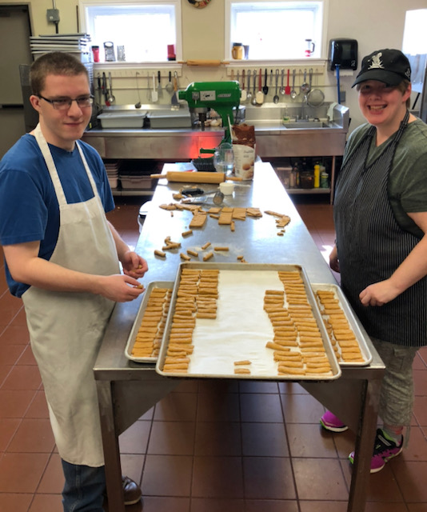
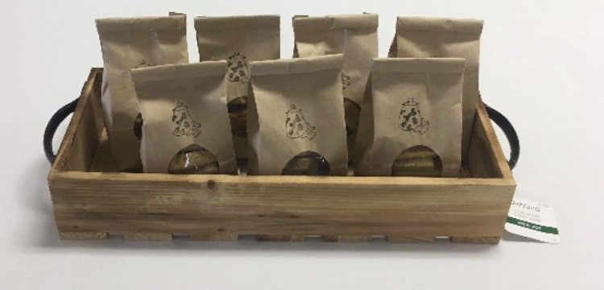
Homemade Dog Treats – Made right here at Summer Street and now sold in the following locations: Good Dog Works, Barkin’ Beauties, Hounds on the Hill, and right here at New Beginnings

Slide 22
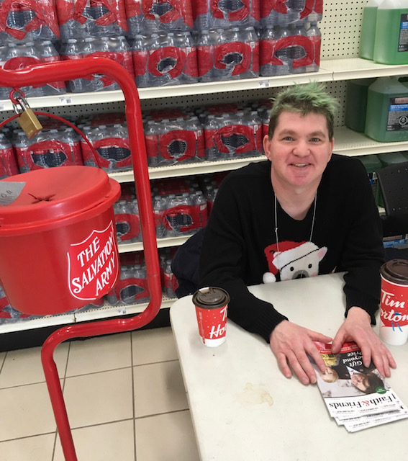
Giving back
We also participate in some volunteering throughout the year:
Here is a picture of one of our participants working at the Salvation Army Kettle Drive

Slide 23
Gross Earnings 2019
In the past calendar year, employees averaged 3000 working hours/month earning an average of $36000 per month

Slide 24
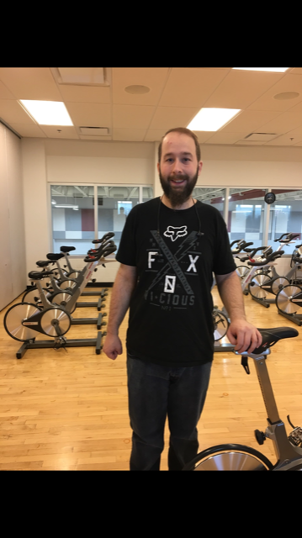
We are looking forward to what 2020 brings
Richard LaSalle
Manager of Employment Services
Phone
902-921-3809
Email
richard@summerstreet.ca

